Slide 1
CSS
MCNDHS
Ms. Eng

Slide 2
AIM: HOW TO CENTER CONTENT IN BOXES and create a tool bar?
Do now:
TAKE OUT YOUR NOTEBOOKS PLEASE
Daily Grade:
On-time/attendance/not leaving the classroom: 25%
Cellphones: 25%
Notes:25%
Classwork/Homework: 25%

Slide 3
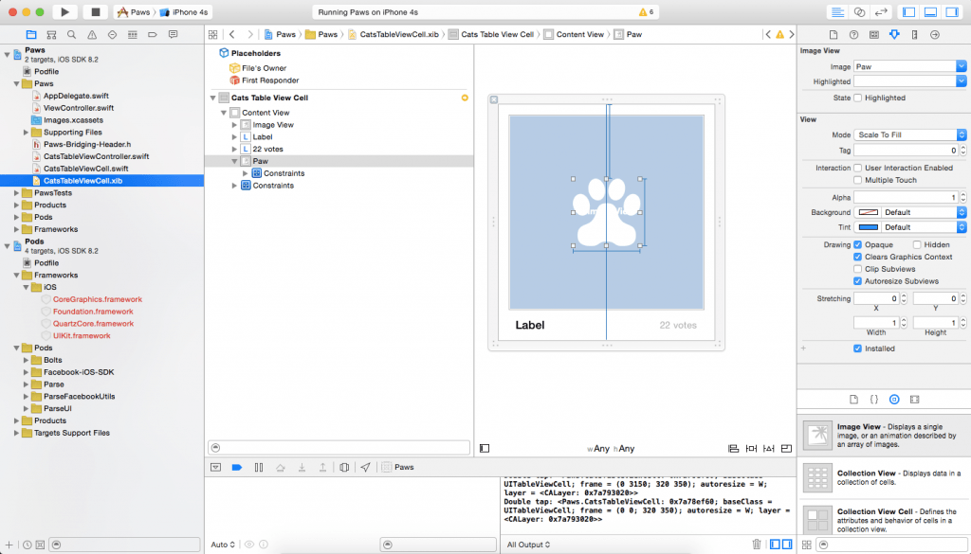
WHERE YOU SEE IT:

Slide 4
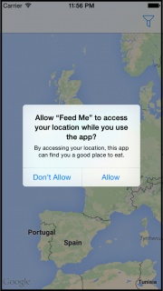
ANOTHER EXAMPLE:

Slide 5
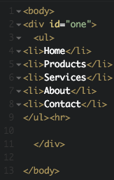
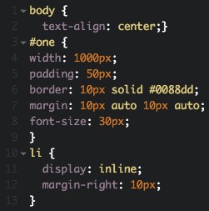
MARGIN AUTO
HTML

Slide 6
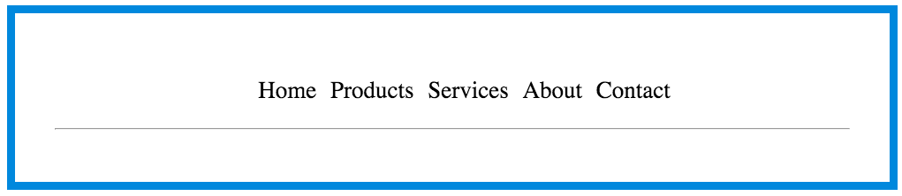
RESULT:

Slide 7
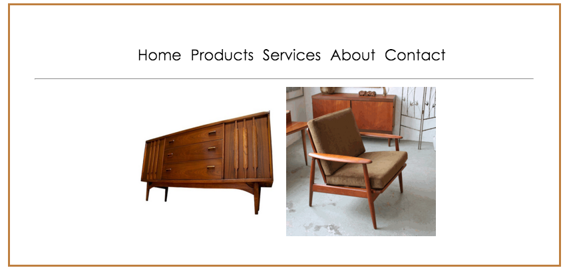
YOU TRY!

